Slide 1
BINDT Practitioner Session
“The Grains of truth”
Alec Smith

Slide 2
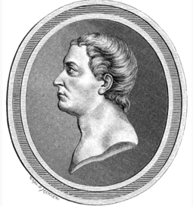
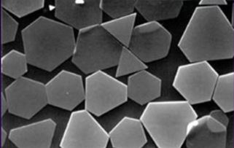
A Brief history…
Photographic sensitivity is not restricted to silver chloride, silver bromide and silver iodide, but it is the most convenient and efficient system.
Hence, the silver halagenides became the basis of modern photography, and, subsequently, radiographic systems.
It has been known that crystals of silver chloride exhibit photosensitivity since the late 18th century (Carl Wilhelm Scheele; 1777).

Slide 3
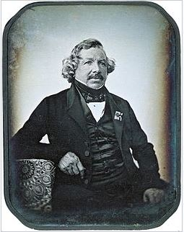
Photography: the early days…
Louis Jacques Mandé Daguerre
Experimented with a mirror-like, silver-surfaced plate, that had been fumed with iodine vapour, producing a surface coating of silver iodide. However, exposure times were impracticably long to produce acceptable images.
Daguerre then made the pivotal discovery that a much shorter exposure time (in the order of minutes) produced an invisible latent image, which could be developed into a permanent image by exposure to mercury fumes. A hot, strong solution of common salt was used to fix the image by removing the remaining silver iodide.
Daguerre (by Sabatier)

Slide 4
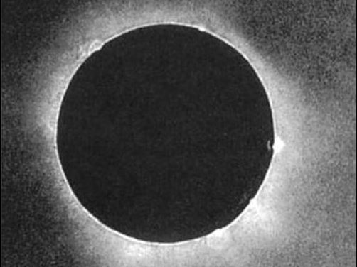
Photography: the early days…
This first complete practical photographic process was announced at a meeting of the French Academy of Sciences on January 7th, 1839.
At first, details of the process were withheld, and specimens were shown only at Daguerre’s studio, to Academy members, under close supervision.
The French government bought the rights to the discovery, in exchange for pensions payable to the originators, and arranged to present the invention to the world as a free gift (with the exception of Great Britain – where it was patented!)
Known as the Daguerreotype process, complete instructions were made public on August 19th, 1839.
Solar Eclipse; 1851

Slide 5
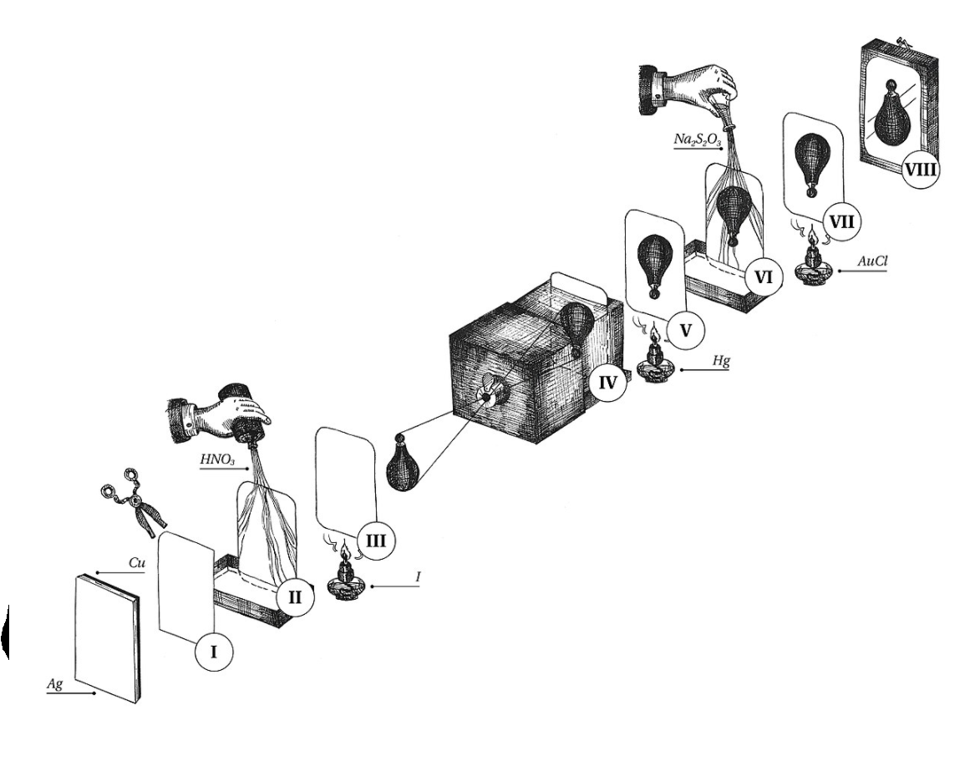
Steps in The daguerreotype process:
Polishing: A silver plated copper sheet was polished to a mirror-like finish, then swabbed with nitric acid
Sensitisation: In a dark room, the polished silver surface was exposed to halogen fumes. Originally iodine to produce silver iodide, but it was discovered that the use of bromine, producing silver bromide, greatly increased sensitivity
Exposure: To create the latent image; exposures could be a few seconds to many minutes

Slide 6
Steps in The daguerreotype process:
Development: The plate was exposed to several minutes of exposure to mercury fumes(!)
Fixing: In the original process, fixing was carried out using a hot common salt solution to remove the remaining silver halide. It was quickly discovered that hyposulphite of soda (“hypo”), now known as sodium thiosulphate, made a more efficient solvent, and its use was adopted. Frequently, gilding, or gold plating was used to give a “warmer” tone, and physically reinforce the powder-like silver particles of which the image was formed.
Daguerreotype images were very delicate; subject to tarnishing and physical damage, so were protected by a cover glass.

Slide 7
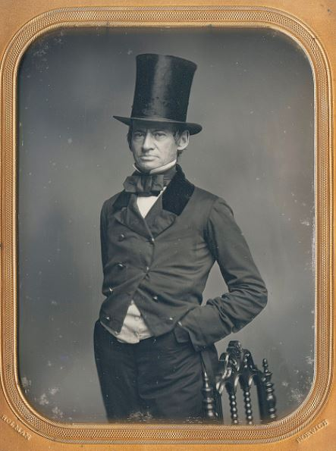
Characteristics of Daguerreotypes
Images are, usually, laterally reversed – mirror images - as they are viewed from the side that faced the subject; though prisms may be used to correct the image.
During viewing of a daguerreotype, the image will “flip” from positive to negative as the viewing angle changes.

Slide 8
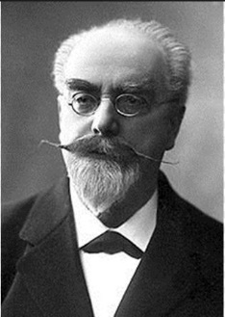
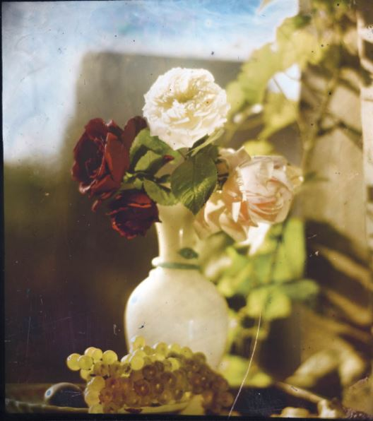
Characteristics of Daguerreotypes
Image is similar to holograms on credit cards or Lippmann plates (Gabriel Lippmann; Nobel Prize for Physics – 1908).
Lippmann developed an early type of direct colour photography.

Slide 9
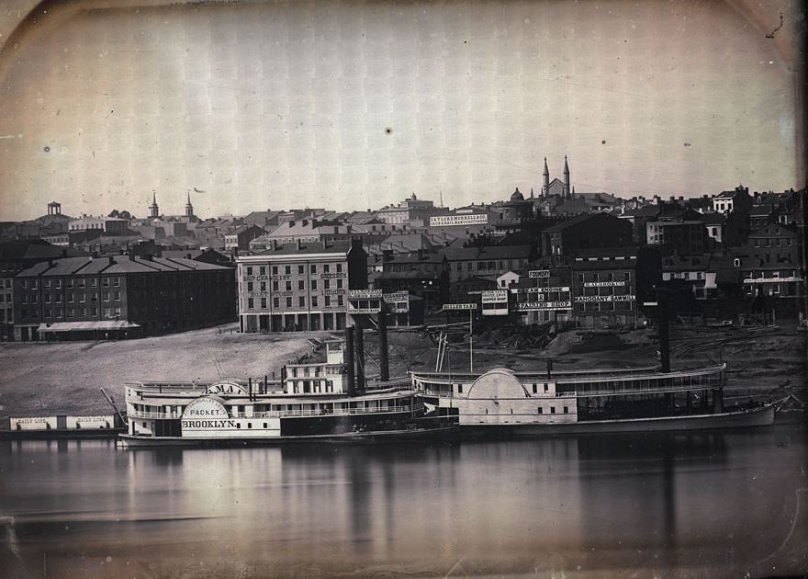
Characteristics of Daguerreotypes
Well exposed, large format, Daguerreotypes have a resolution greater than that achievable by modern digital cameras. In 2007, “conservators” at George Eastman House were working on Daguerreotypes made in 1848, and observed that they exhibited a resolution that would be comparable to a digital image composed of 140,000 megapixels.

Slide 10
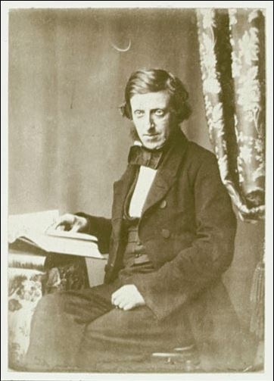
Photography: the early days…
Frederick Scott Archer
Invented an improvement of the calotype process.
The calotype process was invented by Henry Fox Talbot (also, sometimes, called talbotype) which produced a negative image on silver iodide impregnated paper, and a positive image was produced via direct printing.
Archer was dissatisfied with the poor definition and contrast of the calotype, and sought a way of combining the resolution of the daguerreotype with the ability of producing multiple copies of the same image permitted by the calotype process.

Slide 11
Photography: the early days…
Frederick Scott Archer
The result, the collodion process, preceded modern gelatine emulsions.
Scott Archer invented the process in 1848, and published it in The Chemist in 1851 – knowingly without a patent, intending it to be a gift to the world.
Although, by the end of the 1850s, the collodion process had, almost entirely displaced the Daguerreotype, he died impoverished.
An obituary described him as “a very inconspicuous man, of poor health”.

Slide 12
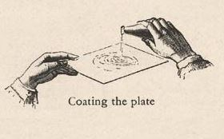
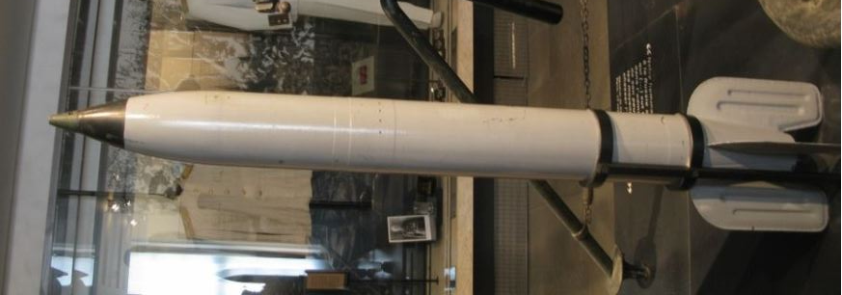
Steps in The collodion process:
Production of collodion: Guncotton (nitrocellulose; ordinary cotton, soaked in nitric & sulphuric acid and permitted to dry) was dissolved in a mixture of alcohol & ether containing potassium iodide. The collodion, a “syrupy” mixture, was poured onto a clean glass plate, to produce an even coating.
M13 Rocket for Katyusha launcher – nitrocellulose motor

Slide 13
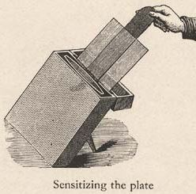
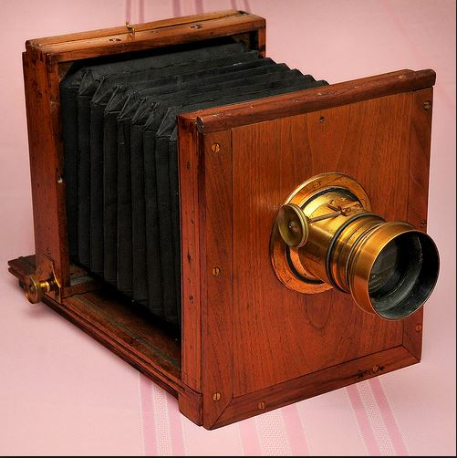
Steps in The collodion process:
Sensitisation: When the collodion was set, but not dry, the plate was immersed in a solution of silver nitrate, which reacts with potassium iodide to produce silver iodide.
Exposure: The plate was placed in a holder, and exposed while still wet – the process was, also, known as the “wet collodion process”.

Slide 14
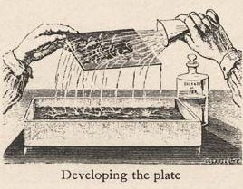
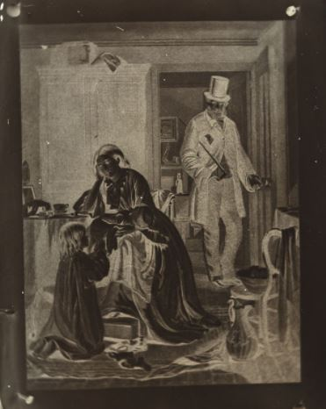
Steps in The collodion process:
Development: After exposure, the plate was immediately developed in a solution of pyrogallic and acetic acid. Latterly, the development was carried out using ferrous sulphate.
Fixing: Plate was immersed in sodium thiosulphate solution to remove undeveloped silver iodide, then washed and dried. The plate negative was then varnished for protection.

Slide 15
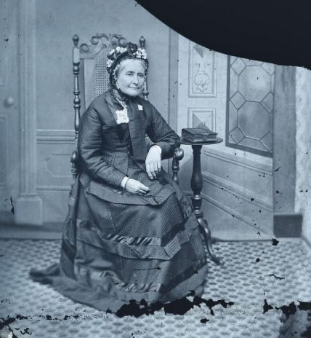
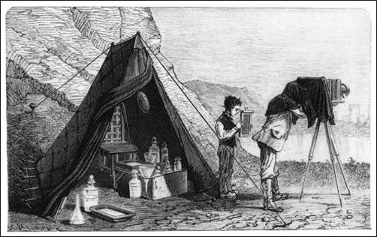
Advantages of The collodion process:
The glass negative could be used to produce multiple copies of the same image, and was, relatively inexpensive, compared to the Daguerreotype.
disadvantages of The collodion process:
The entire process, from coating to development, had to be completed before the plate dried – around 10 minutes.
If used in the field, it required the use of a mobile darkroom.
As with preceding processes, the collodion process was sensitive only to blue light; hence the appearance that sitters in collodion photographs appear to be in mourning, but may have been wearing yellow or pink

Slide 16
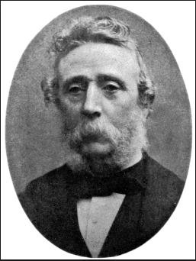
Photography: Approaching modernity…?
Richard Leach Maddox
Realised his health was being affected by the ether vapour used in the wet collodion process, Maddox began looking for a substitute, a transparent substance that could bind light sensitive materials to glass.
He combined silver bromide with a variety of “vegetable gummy matters” and “starchy substances”.
Finally, he tried gelatine from a packet of “Nelson’s Gelatine Granules”.

Slide 17
Photography: Approaching modernity…?
Richard Leach Maddox
He discovered that the plates could be developed long after exposure, and that they were around 60x more light sensitive than the dry collodion process.
His findings were published, without patent, on 8th September, in the “British Journal of Photography”, before his trials were fully complete.
The lack of patent permitted further improvements to be made to the process in a very short time …

Slide 18
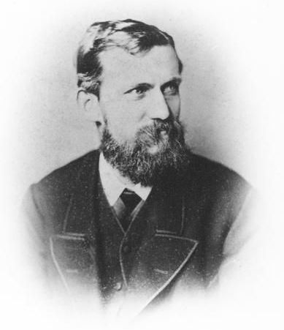
Photography: Approaching modernity…?
Charles Harper Bennett
Bennett improved the Maddox process in two key ways:
1873 – Discovered a method of hardening the gelatine, making it more resistant to physical damage.
1878 – Applied a heat treatment process to improve light sensitivity.
Now, the plates offered long term storage stability and the possibility of 1/25 second exposure times.

Slide 19
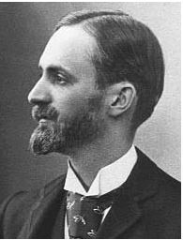
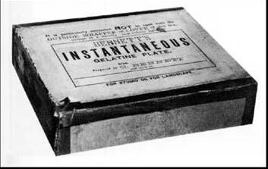
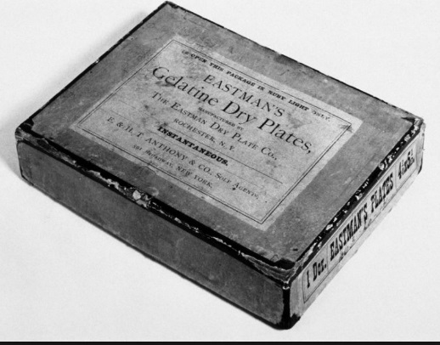
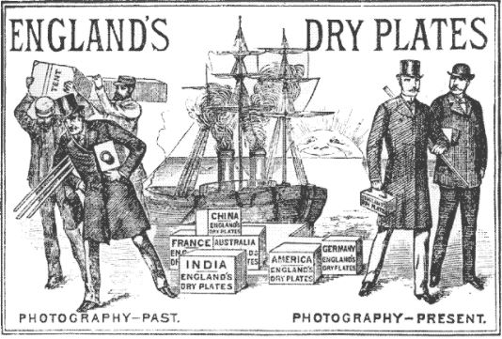
Photography: Approaching modernity…?
George Eastman
In 1879, Eastman invented an emulsion coating machine, enabling mass production of photographic dry plates, and in 1880 opened the “Eastman Dry Plate Co.” in Rochester, N.Y.
This was one of more than 14 firms manufacturing dry plates.

Slide 20
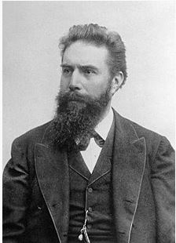
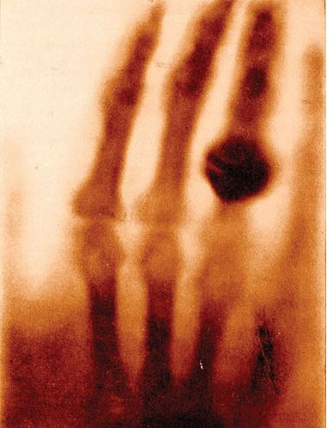
radiography: the beginning…
Wilhelm Conrad Roentgen
The discovery of x-rays is attributed to Roentgen on November 8th, 1895; for which he was awarded the first Nobel Prize for Physics.
Probably, the most famous radiograph ever taken was the hand of Roentgen’s wife, Bertha.

Slide 21
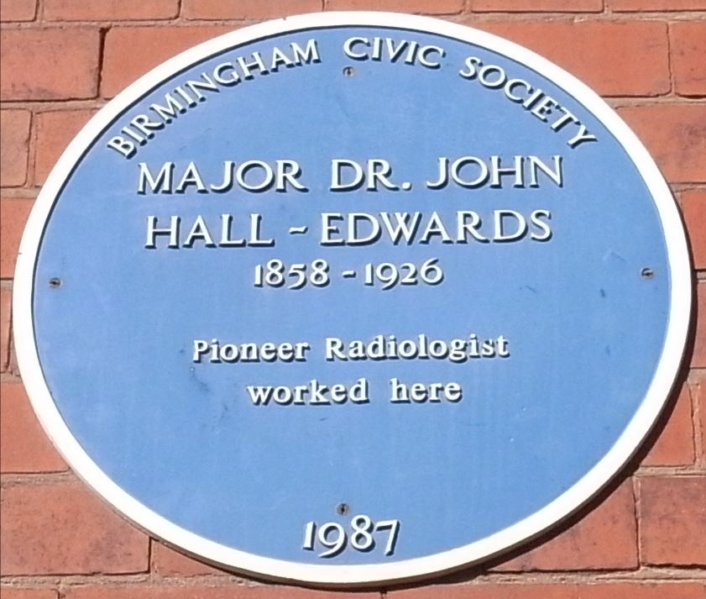
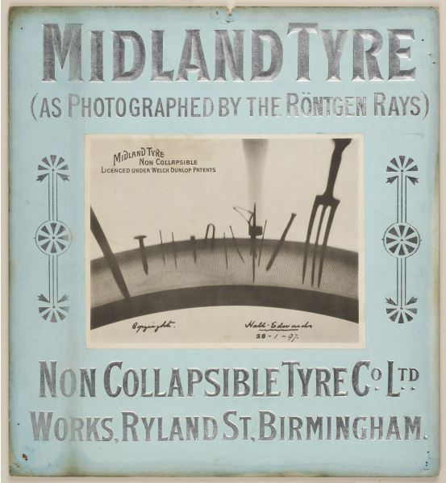
radiography: the beginning…
This revolutionary new development was quickly adopted into medicine, and the first use in this field was by John Hall Edwards in Birmingham on January 11th, 1896 – who may have, inadvertently, indicated its future use in industrial applications …?

Slide 22
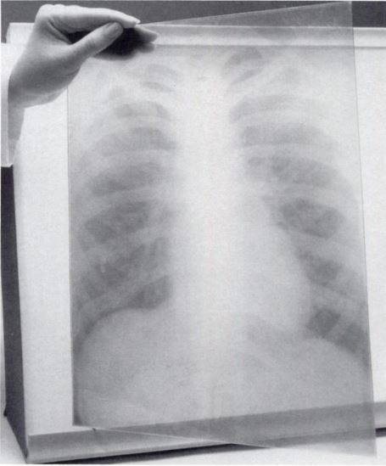
radiography: time line of silver halogen based radiographic imaging systems
Early radiographs were produced using the single emulsion dry, photographic, glass plates described earlier.
Glass plate radiograph; 1912

Slide 23
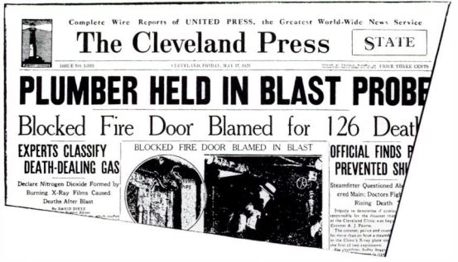
radiography: time line of silver halogen based radiographic imaging systems
1913: Cellulose nitrate based x-ray film introduced
1918: Eastman introduce first double emulsion film for radiography. Practitioners were reluctant to adopt film, and continued to use glass plates for many years
1924: First x-ray film with a cellulose acetate base (“safety film”) introduced, but, again, practitioners were reluctant to adopt
1933: Use of nitrate based film discontinued, partially prompted by the Cleveland Hospital fire of 1929
1933: Blue tinted base introduced

Slide 24
The latent image: Gurney – Mott theory
The concept of the latent image was a crucial factor in the progression of silver halide imaging systems since their first successful demonstration by Daguerre in 1839, but it was not until 1938 that the first practical theory of latent image formation was proposed by R. W. Gurney & N. F Mott.
The emulsion of a radiographic film comprises of microscopically small grains of silver bromide (AgBr – approx. 98%) and silver iodide (AgI – approx. 2%) suspended in a gelatine matrix. These grains exhibit an individual response to actinic radiation, and the subsequent reaction with a chemical developer.

Slide 25
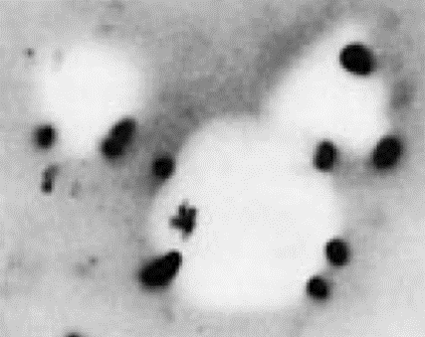
The latent image: Gurney – Mott theory
The definition of the latent image may, thus, be described as: “A radiation induced change in a silver halide grain, which renders that grain more susceptible to the chemical reaction of a chemical developer.”
The physical nature of the latent image was fairly well known, but, due to the extremely small changes in the silver halide grains (involving a few atoms in a single grain), direct investigation of the mechanism of formation was difficult.
It can be demonstrated, for example, that given a brief development, and subject fixation, an exposed film will exhibit formation of metallic silver at discrete sites on the exposed grain. These sites became known as sensitivity specks.
Electron micrograph showing initiation sites; total image size ~ 1.5 x 2.0 µm

Slide 26
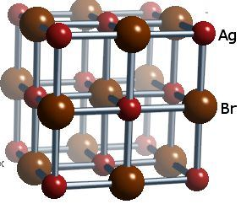
The latent image: Gurney – Mott theory
According to the Gurney – Mott theory of latent image formation, “imperfections” in the regular lattice arrays of a silver bromide grain permit, or, promote, the formation of these “sensitivity specks”. These imperfections include:
Silver ions which do not occupy the “lattice position” – these are known as interstitial silver ions
Physical imperfections in the crystalline structure
Impurities in the grain structure – foreign molecules – the most significant of which is silver sulphide; Ag₂S. Small amounts of silver sulphide were already known to increase the sensitivity of silver halide emulsions
Typical position of interstitial silver ion

Slide 27
The latent image: Gurney – Mott theory
Silver bromide is a compound, formed by the “bonding” of a silver atom with a bromine atom. “Bonding” in compounds is achieved by the “sharing” or “transference” of what are known as valence electrons between atoms in a compound.
Effectively, when silver bromide is formed, a silver atom transfers its valence electron to a bromine atom. Hence, the silver atom now lacks a single negative charge, becoming positive in nature, and so is known as a positive silver ion (Ag⁺).
Conversely, the bromine atom now “possesses” an extra single negative charge, and, as such, can be described as a negative bromide ion (Br⁻).
(To be strictly chemically accurate, the above describes an ionic bond, where the Ag-Br bond is, more correctly, described as a polar covalent bond, but has a strong ionic character, permitting the use of this, more simple, model.)

Slide 28
The latent image: Gurney – Mott theory
When silver bromide (AgBr) molecules are exposed to “actinic” radiation, which may be light below a certain wavelength (direct radiographic films are sensitive to light at the “blue” end of the spectrum, permitting red lighting to be used during processing), or electrons produced by Compton or photoelectric absorption events, they become ionised.
This is the beginning of latent image formation.

Slide 29
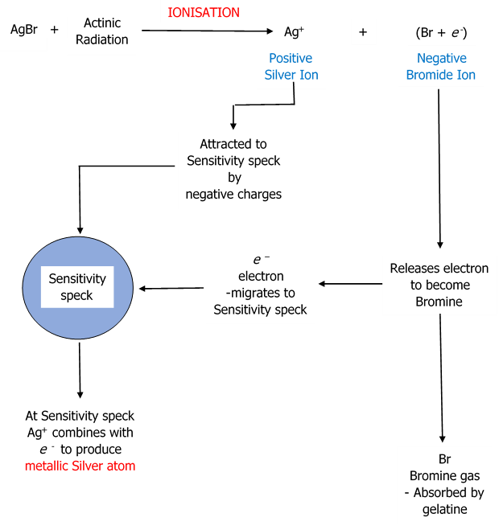
The latent image: Gurney – Mott theory
The stages in latent image formation may be described, formulaically, as:

Slide 30
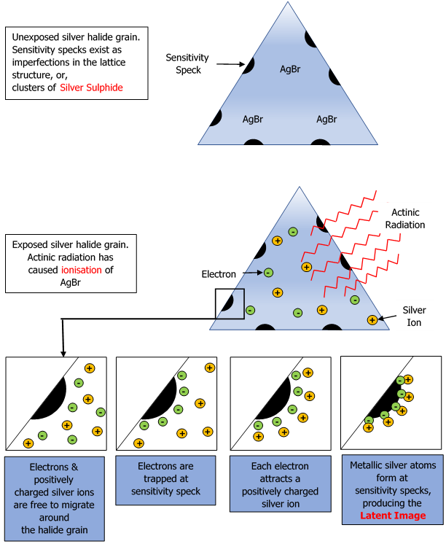
The latent image: Gurney – Mott theory
The same process may be demonstrated diagrammatically as follows:

Slide 31
Development of the latent image
The process of development is one of the major advantages of the silver halide imaging system.
Development is a chemical process by which silver halides are converted to metallic silver. However, the developer is selected such that the reaction is limited solely to the grains which exhibit latent image formation.
In other words, developer chemical selection is confined to those chemicals in which the reaction is catalysed (“speeded up”) by the presence of the photolytic silver of the latent image.
In the most sensitive of emulsions, the number of silver atoms, at the latent image site, required to trigger this reaction, may be fewer than 10.

Slide 32
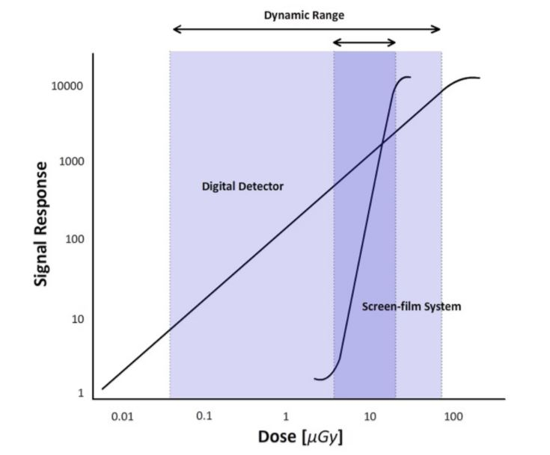
Development of the latent image
As the number of silver atoms in each silver halide grain is in the order of billions, this results in a chemical amplification of around x10⁹.
This chemical amplification is one of the major advantages of radiographic film as an imaging system, as it results in high contrast radiographic images.
Gradient, or, “slope” of characteristic curve indicates film contrast

Slide 33
Thank you
For more information please contact:
IMechE Engineering Training Solutions
T: +44 (0)114 399 5720
E: trainingsolutions@imeche.org
W: http://trainingsolutions.imeche.org

